Slide 1
UNIT III - CLOUD COMPUTING FOR EVERYONE
Centralizing email Communications
Cloud computing for families by examining how a typical family an use cloud-based tools to help improve communications between family members.
The key here is to enable anywhere/anytime access to email. If you wanted to check your home email from work, it took a bit of juggling and perhaps the use of your ISP’s email access web page. That web page was never in sync with the messages on your home PC, of course, which is just the start of the problems with trying to communicate in this fashion.
A better approach is to use a web-based email service, such as Google’s Gmail (mail.google.com), Microsoft’s Windows Live Hotmail (mail.live.com), or Yahoo! Mail (mail.yahoo.com). These services place your email inbox in the cloud; you can access it from any computer connected to the internet.

Slide 2
Collaborating on Schedules
It comes to coordinating multiple individuals or families in a community activity; you have your work cut out for you. Whether it’s a youth sports team, community organization, school event, or some community event, trying to line up who’s free and who’s not on a given evening takes a lot of effort—unless, that is, you’re using web-based scheduling tools.
One of the most common community activities: youth sports. whatever the sport, there’s a lot of activities that need to be scheduled—practices, home games, away games, team meetings, you name it. Multiply the number of players (and coaches) on each team times the number of events, and you see the complexity; it gets even worse if you’re trying to manage events for an entire league.

Slide 3
Collaborating on To-Do Lists
Let’s start with simple task management, in the form of the old-fashioned todo list. These are web-based lists that multiple group members can access from any web browser. Tasks are entered (complete with due date) and checked off when completed.
(www.blablalist.com), Remember the Milk (www.rememberthemilk.com),
Ta-da List (www.tadalist.com), Tudu List (www.tudulist.com)

Slide 4
Remember the Milk
When you need to “remember the milk” at the grocery store, check out the aptly named Remember the Milk (www.rememberthemilk.com) web-based to-do list manager. Once you create a list, you can arrange reminders via email, instant messaging, or text messages to your mobile phone.

Slide 5
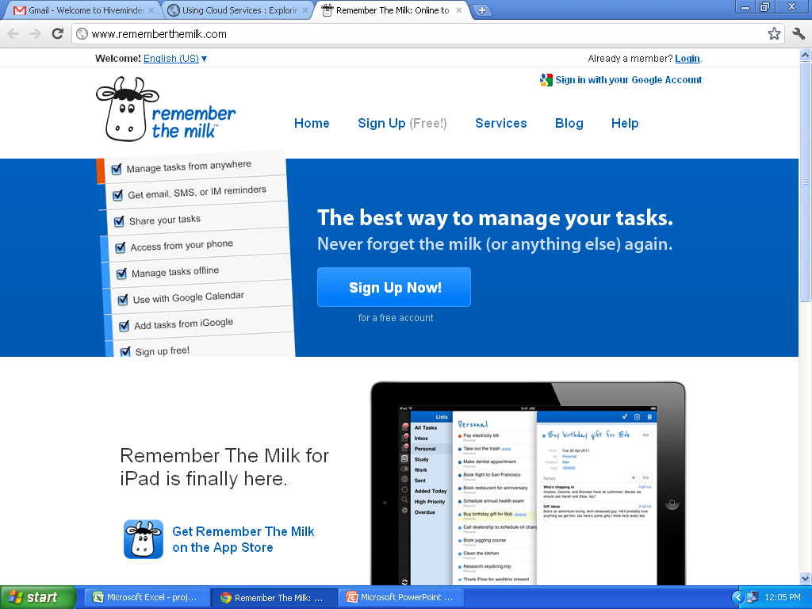

Slide 6
Ta-da List
Here’s another web-based to-do list manager. Ta-da List (www.tadalist.com) lets you make all sorts of lists, share them with friends, family, and co-workers, and then check off items as they’re completed.

Slide 7
You can use Ta-da List to keep track of...
Thank you notes to write
Restaurants to check out
Household everyday jobs for your spouse
Cities you want to visit
Homework assignments
Agenda for the weekly meeting
Famous quotes you don't want to forget
Things to pack for your trip
People to invite to the party
Points to discuss on the conference call
...and a whole lot more...

Slide 8
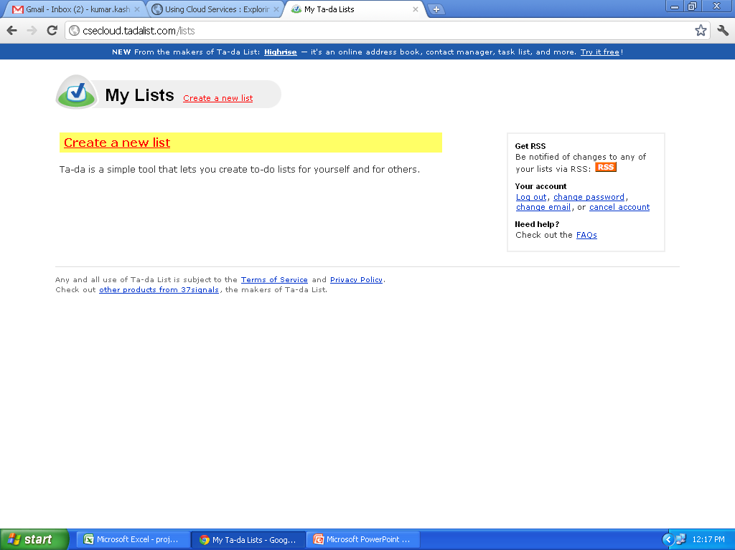

Slide 9
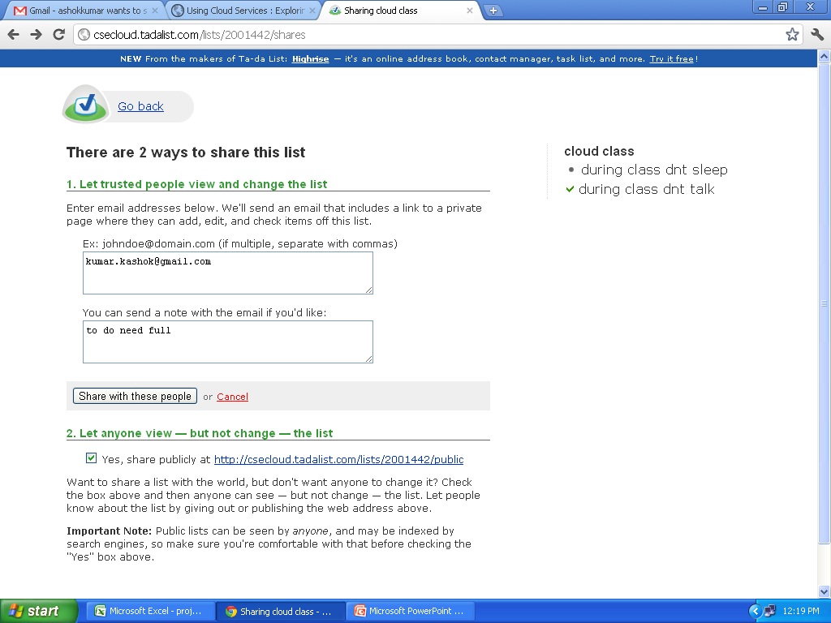

Slide 10
Tudu List
Tudu List (www.tudulist.com) is a little different from other to-do list managers in that it also includes a web-based calendar. Items are added both to the appropriate to-do list and to your calendar, on the date they’re due.

Slide 11
Tudu Lists is an on-line application for managing todo lists.
Tudu Lists is a very simple application, which you can start using in seconds - but with some advantages over your home-made Excel todo list:
Tudu Lists is web-based, and accessible from anywhere on the planet.
Tudu Lists can be shared amongst people: you can share lists with your friends, family or co-workers.

Slide 12
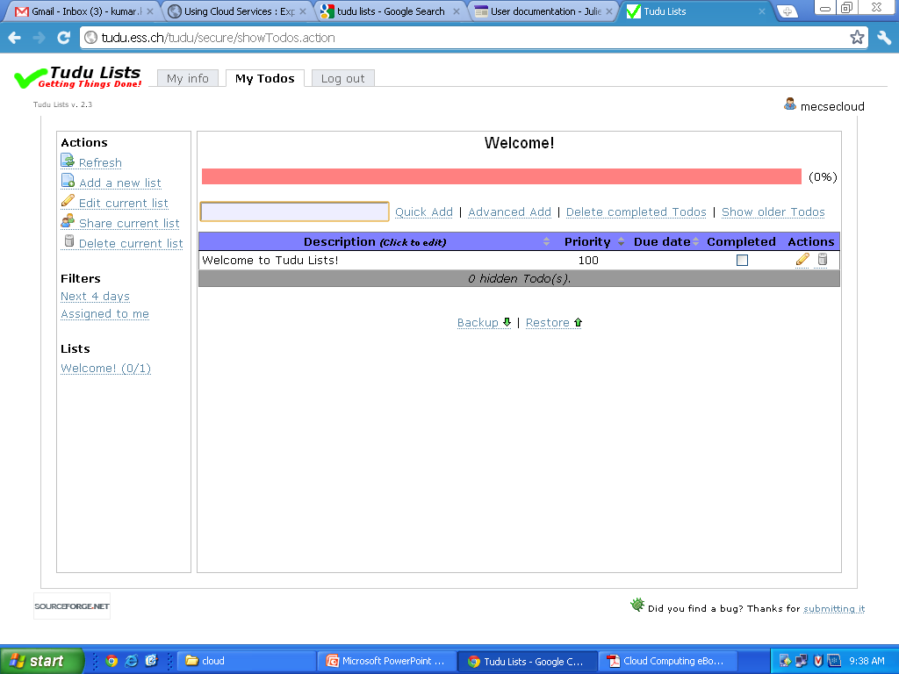

Slide 13
Collaborating Contact Lists.
Salespeople have to deal with lots and lots of contacts. Not only is their address book full, they need to know when to contact certain clients, when follow-up calls are necessary, what the boss needs them to do today, and the like.
The solution, of course, is a web-based contact management or customer resource management (CRM) application. These programs are tailored to the needs of a busy salesperson and come complete with features such as activity scheduling, appointment reminders, email templates, and the like. Among the most popular of these applications are BigContacts
(www.bigcontacts.com), Highrise (www.highrisehq.com), and the market leading Salesforce.com (www.salesforce.com).

Slide 14





Our IT Vision: Salesforce on Salesforce
Organization
Operations
Infrastructure
Improve Productivity & Innovation
Improve Efficiency
Reduce Cost

Slide 15
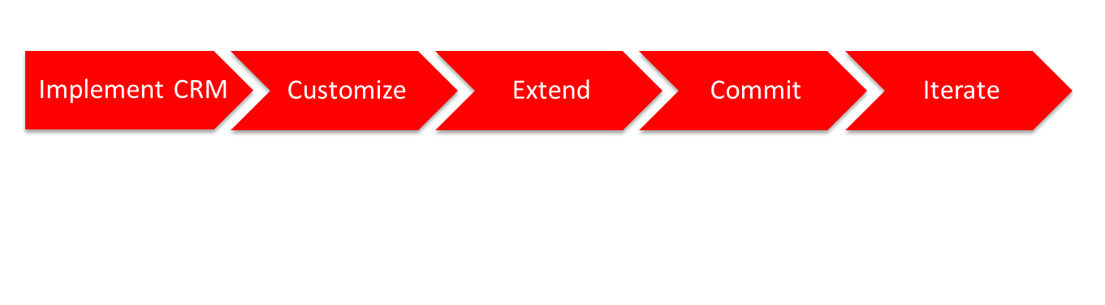
Our Transformation Took Five Stages
Implement Salesforce applications
Create business specific requirements
Add complex functionality
Design, build and deploy mission critical applications
Continuously improve existing apps and deliver new apps

Slide 16
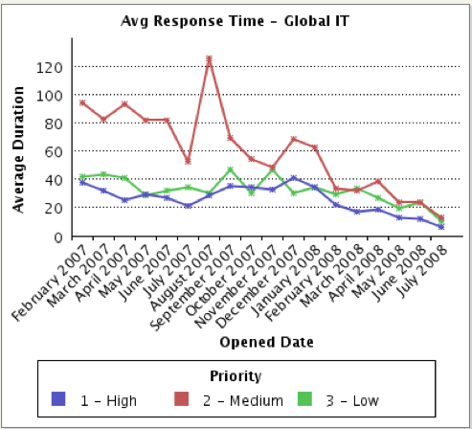


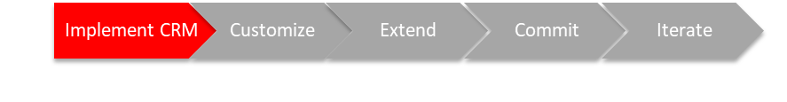
Stage 1: Implement Core CRM Solution
Implement change management strategy
Centralize Salesforce administration into IT
Define and build operational processes
Notes:
Redo this slide to just one vertical with our implemenation of CRM and core products

Slide 17





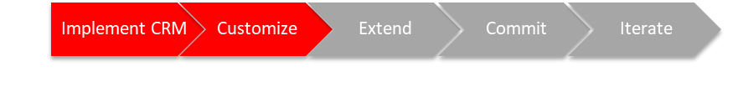
Stage 2: Customize to Automate Basic Processes
Eliminate rogue spreadsheets, manual processes and databases
Review project portfolio for cloud opportunities
Train All IT Employees on Force.com
Develop integration strategy and solutions
Notes:
This is where we had Jon Mar focused on building the quarterly certification object. It is a time to start training the developers and admins and also provide IT automation tools.

Slide 18
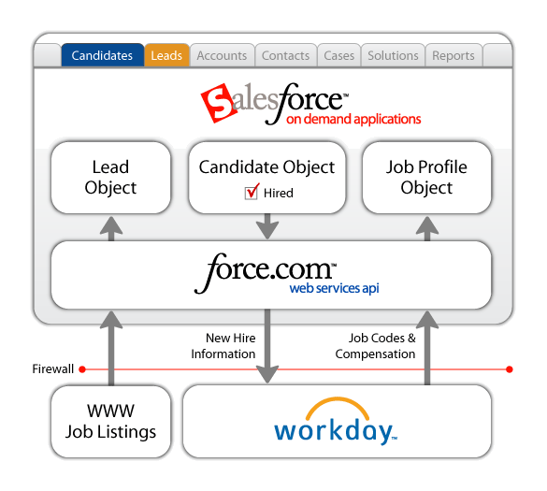

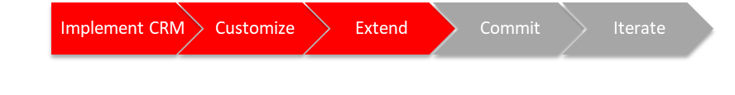
Stage 3: Extend Automation with Custom Apps
HCM and Recruiting
Organizational alignment with cloud model
Agile development methodology to develop 5 times as fast with half the cost
Refine business and IT roles and processes to reduced project requests by 70%
Notes:
Have Alex add in the portal function here…change integration server to Integration Bus or remove

Slide 19

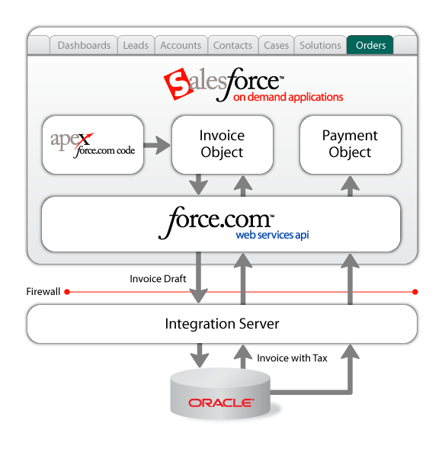


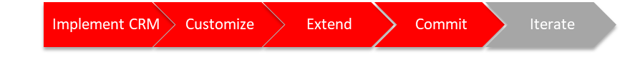
Stage 4: Commit to Platform for App Development
Quote to Cash
Transitioned 30% of IT Staff to development
Delivered projects 5 times faster
Deployed complex business automation. Cost avoidance of $120K capital and 22% reduced maintenance for one project
Reduce datacenter footprint with 40% reduction in cost
Enterprise Service Bus

Slide 20
Stage 5 Iterate: Run Our Business in the Cloud
Human Capital Management
Customer Service
Sales & Marketing
IT Infrastructure
Compliance and Risk
Finance
Development
Workday HCMD
Salary.com Salary Manager
Performance Management
Time-off Manager
Volunteer tracking
ADP Payroll
iemployee Time Tracking
Coupa Procure to Pay
Concur T&E Manager
Manhattan Space & Lease Management
Contract Management
Salesforce Customer Service
Salesforce Content
Salesforce Ideas
Plateau Learning Management
Professional Services Management
SFA
Marketing
Click to dial (CTI Integrations)
Event Management
Opportunity to Quote
Quote to cash
Sales Compensation
Checkout E-commerce
Live Chat (Google)
Development Domain
Program and Resource Management
Agile Scrum and Bug Management
QA Test Director
IT Infrastructure Support
Portfolio Management
Compliance
IT Help Desk
LiveOps
Asset Management
Intranet
Google Apps
Compliance/Risk Domain
Audit Controls Management

Slide 21
Cloud Computing for the community
One of the key components of any community collaboration is communication.
That makes using traditional desktop email, such as Microsoft Outlook or Windows Mail, problematic. The better solution when communication on community issues is to use a web-based email program, such as Gmail (mail.google.com), Microsoft Windows Live Hotmail (mail.live.com), or Yahoo! Mail (mail.yahoo.com).
These programs can be accessed from any computer connected to the Internet. You use your web browser to send and view email messages hosted on the web.

Slide 22
Collaborating on Group Projects and Events
Community groups often have a lot on their plates. Someone has to schedule the next fundraiser, someone else needs to print up flyers, someone else is in charge of recruiting new members…there’s just a lot of stuff to do! How does your community group manage all these activities?
In the new world of cloud computing, the best way is with a web-based application— which anyone in the group can access.

Slide 23
Cloud Computing for the Corporation
Companies large and small recognize the cost savings and productivity enhancements of using web-based tools to manage projects, collaborate on documents and presentations, manage enterprise wide contacts and schedules, and the like.
Managing Schedules
Managing Contact Lists
Managing Projects
Collaborating on Reports
Collaborating on Marketing Materials
Collaborating on Expense Reports
Collaborating on Budgets
Collaborating on Financial Statements
Collaborating on Presentations
Presenting on the Road
Accessing Documents on the Road

Slide 24
Managing Schedules
Appointment Quest Online Appointment Manager — easy to use web-based appointment scheduling software solution. Appointment Quest enables you to manage your customers, personnel, schedules, appointment calendars — all in one place, from any place.
Appointment Quest Online Appointment Manager can be used as an internal scheduling system, or be configured to allow your customers to book appointments with you online. You can use it in a single location, or across multiple offices. You can have multiple users working in it at the same time, scheduling appointments simultaneously — no mistakes, no overbooking, all in real-time.
http://www.appointmentquest.com/

Slide 25
Managing Contact Lists
Salespeople have to deal with lots and lots of contacts. Not only is their address book full, they need to know when to contact certain clients, when follow-up calls are necessary, what the boss needs them to do today, and the like.
The solution, of course, is a web-based contact management or customer resource management (CRM) application. Among the most popular of these applications are BigContacts
(www.bigcontacts.com), Highrise (www.highrisehq.com), and the market leading Salesforce.com (www.salesforce.com).

Slide 26
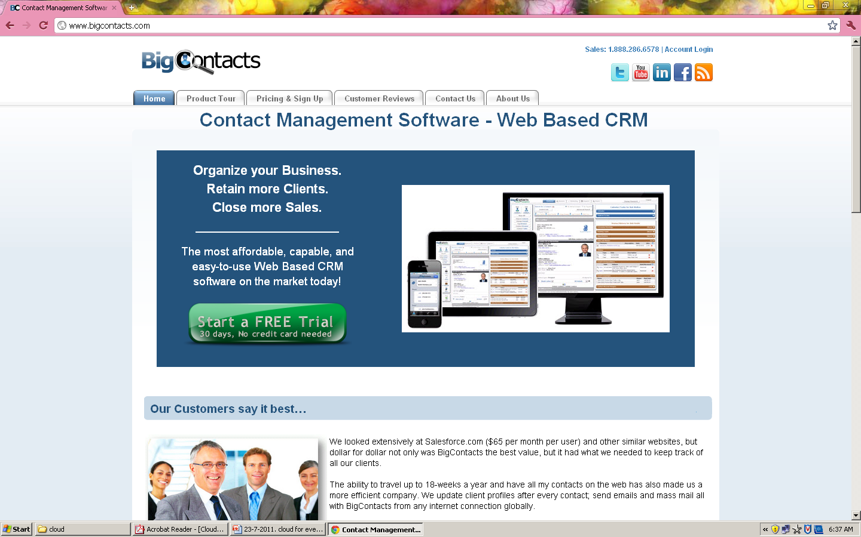
Managing Contact Lists

Slide 27
Managing Projects
easier with the use of a web-based project management application.
features may include group to-do lists, web-based file sharing, message boards, time and cost tracking, and so on.
And the most robust of these apps lets you manage multiple projects simultaneously; users can schedule their time across multiple projects and make sure they’re not doing two things at once.

Slide 28
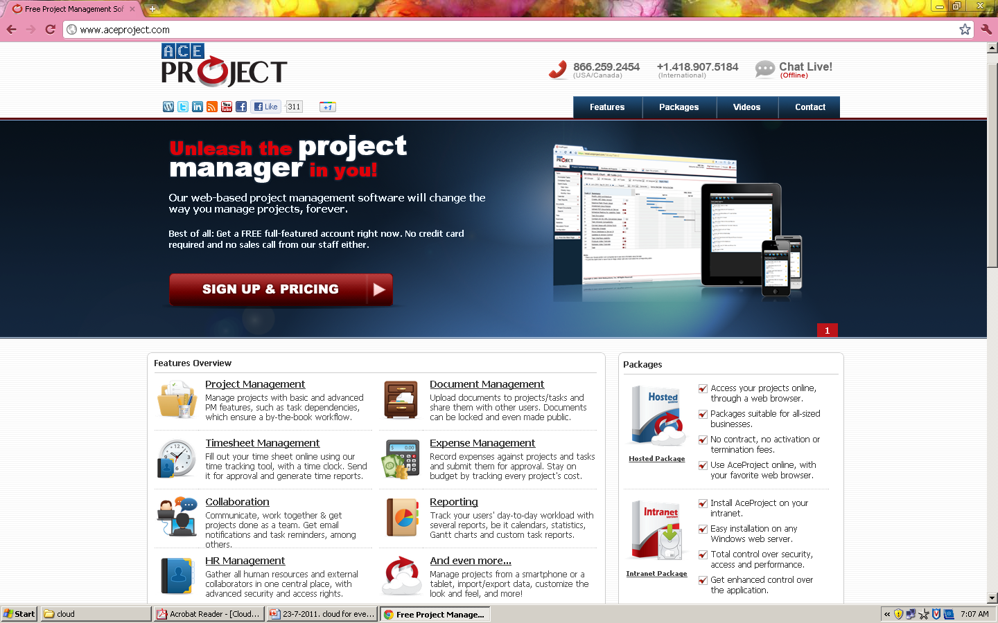

Slide 29
Collaborating on Reports
online collaboration is one of the chief benefits of cloud.
  such as Google Docs (docs.google.com) or Zoho Writer (writer.zoho.com).
Access the same master document, online and in real time.
web-based word processors work in conjunction with full-fledged web based office suites.

Slide 30
Collaborating on Expense Reports
If you spend your company’s money, you have to account for it.
The paper or electronic report must then wend its way through your company’s various levels of approval: your boss, your boss’ boss, the accounting department, the HR department, and who knows how many more people before the accounting folks finally cut you a check.
the expense reporting function on the web.

Slide 31
Collaborating on Budgets
we’re on the topic of money,
Every department is involved, with managers required to submit complete department budgets
a web-based application to create a single budget document for all departments on the web.

Slide 32
Collaborating on Financial Statements
Presenting on the Road
  lets you have real-time text-based interaction with interested participants.
  called web conferences

